Slide 1

Exploring Health Data Trends
DIABETES DATA ANALYSIS
EXPLORING HEALTH METRICS AND THEIR RELATIONSHIP WITH DIABETES

Slide 2
TABLE OF CONTENT
INTRODUCTION:
EXPLORATORY DATA ANALYSIS (EDA):
HYPOTHESIS TESTING:
CONFIDENCE INTERVAL ANALYSIS:
CONCLUSION:
DISCUSSION:

Slide 3

OVERVIEW OF DIABETES DATASET
Importance in Health Research
The Diabetes Dataset provides crucial information on patient data, allowing researchers to analyze trends and patterns. Understanding these insights is essential for developing effective treatments and improving patient outcomes in diabetes care.
This dataset plays a pivotal role in advancing diabetes research, offering valuable insights into risk factors and management strategies. By leveraging this information, researchers can contribute to better healthcare solutions for those affected by diabetes.

Slide 4
UNDERSTANDING DATASET
columns meaning
Pregnancies: Number of times the patient has been pregnant.
Glucose: Plasma glucose concentration after a 2-hour oral glucose tolerance test.
BloodPressure: Diastolic blood pressure (mm Hg).
SkinThickness: Triceps skinfold thickness (mm).
Insulin: 2-hour serum insulin (mu U/ml).
BMI: Body mass index (weight in kg/(height in m)^2).
DiabetesPedigreeFunction: A function that represents the patient’s diabetes pedigree (i.e., likelihood of diabetes based on family history).
Age: Age of the patient (years).
Outcome: Binary outcome (0 or 1) where 1 indicates the presence of diabetes and 0 indicates the absence.

Slide 5

EDA INSIGHTS
High Glucose Levels: Strongly associated with diabetes.
BMI Distribution: Higher BMI correlates with increased diabetes risk.
Age Trends: Older patients show elevated glucose levels.

Slide 6
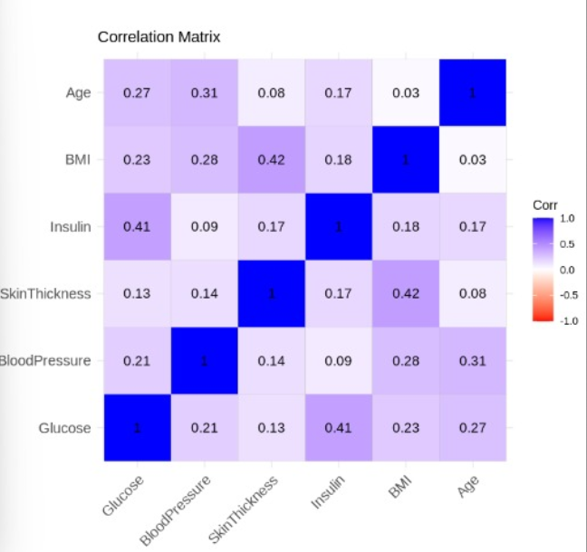
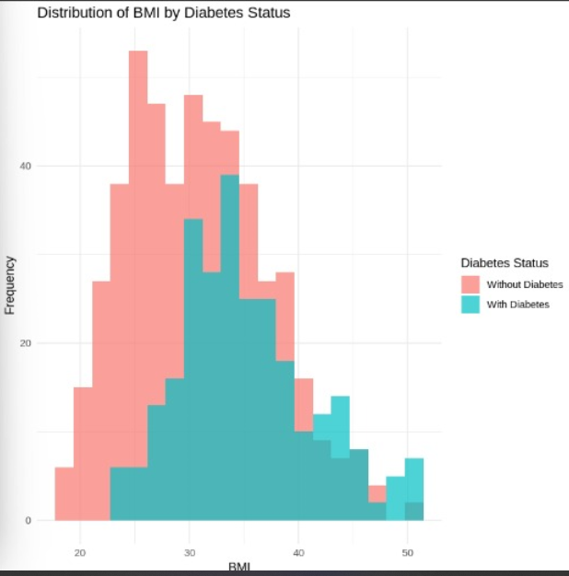
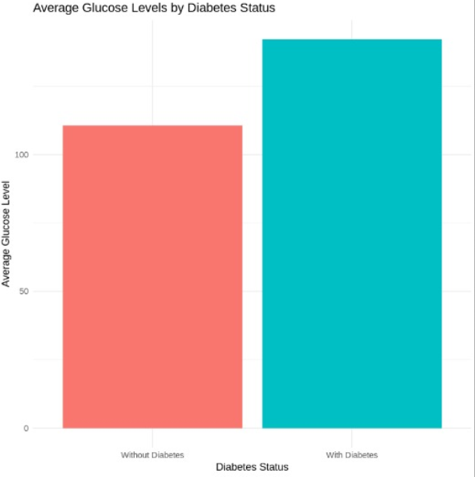
VISUALIZING THE DATA
CORRELATION MATRIX
BARGRAPH OF DIABETES AND NON-DIABETES
CORRELATION MATRIX FOR NUMERICAL COLUMNS

Slide 7

DISTRIBUTION INSIGHTS
- BMI Distribution:
- Right-skewed distribution highlights obesity risks.
- DPF Trends:
- Higher scores for diabetic patients.
- Visual Aids.
- Histogram of BMI
- Line graph of DPF values

Slide 8

HYPOTHESIS TESTING
CLAIM 1:
SIGNIFICANT DIFFERENCE IN GLUCOSE LEVELS BETWEEN DIABETIC AND NON-DIABETIC patients.
Claim 2:
Higher BMI is associated with higher glucose levels.

Slide 9
RESULTS
CLAIM 1:
P-VALUE < 0.05; REJECT THE NULL HYPOTHESIS.
CLAIM 2:
POSITIVE CORRELation observed.
Conclusion:
Glucose and BMI are significant diabetes indicators.

Slide 10

CONFIDENCE INTERVAL ANALYSIS
OBJECTIVE:
Explore precision in estimates through simulations.
Sample Sizes Analyzed:
15, 100, and 10.

Slide 11
CONFIDENCE INTERVAL ANALYSIS
SAMPLE SIZE 15:
BROAD INTERVALS; HIGHER VARIABILITY.
Sample Size 100:
Narrow intervals; improved precision.
Sample Size 10:
Highlighted trade-offs in accuracy.

Slide 12
CHALLENGES AND LIMITATIONS
- CHALLENGES:
- Missing data handling
- Statistical interpretation
- Limitations:
- Dataset restricted to female patients.
- Assumptions:
- Equal variance, normal distribution.

Slide 13

CONCLUSION
Findings:
Glucose levels, BMI, and age are critical indicators of diabetes risk.
Larger sample sizes improve the reliability of statistical estimates.
Implications: Targeted health monitoring and interventions are essential for at-risk groups.

Slide 14

"QUESTIONS AND DISCUSSION"

